Slide 1
Glocalization – Think global, act local
AIMS-Lecture on
24.10.2011 in Baramati/India
International Competitiveness
and the BRIC-Countries -
A new Centre of the Global Economy
Prof. Dr. Norbert Koubek
Schumpeter School of
Business and Economics
University of Wuppertal/Germany

Slide 2
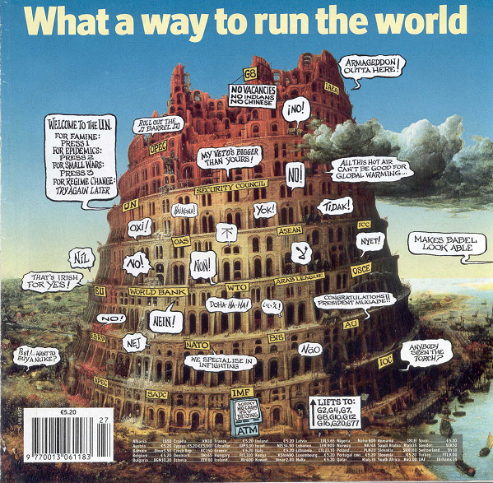
The BRIC – Countries and the World
Source: The Economist, July 5th – 11th, 2008

Slide 3
I. BRIC - Countries

Slide 4
Comparison of BRIC-Countries
Countries | Landscape in Mio. km | Population 2008 in Mio. | GNP 2009 in Mio. USD
Brasil | 8,512 | 191,909 | 1.574.039
Russia | 17,075 | 140,702 | 1.229.227
India | 3,288 | 1.147,996 | 1.235.975
China | 9,597 | 1.330,045 | 4.908.982
EU | 4,325 | 491,019 | 16.447.259
USA | 9,827 | 303,825 | 14.256.275
2
Source: International Monetary Fund (2010).

Slide 5
GNP of BRIC-Countries total und per capita in 2010 in US-Dollar
Source: Fischer Weltamanach (2010).

Slide 6
Real-Growing Figures of GDP in 2010
Source: Fischer Weltamanach (2010).

Slide 7
Foreign Direct Investment 2010 in Bill. US $
Source: Bundesagentur für Außenwirtschaft (2010)b, Deutsche Botschaft Moskau (2010), IBEF (2010), Wirtschaftswoche (2010).

Slide 8
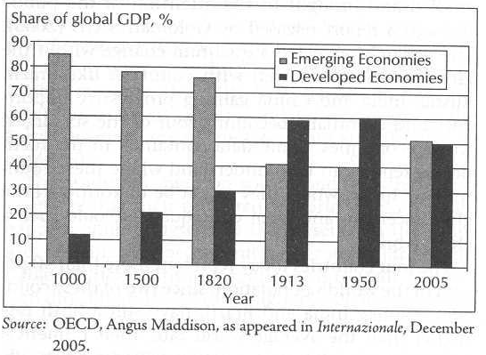
Emerging Countries Coming Back

Slide 9
The Largest Economies in 2050 (USD trillion)

Slide 10
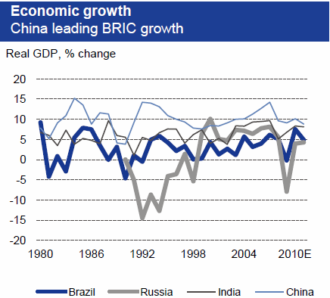
The BRIC-Countries
Quelle: DB Research 2011.

Slide 11
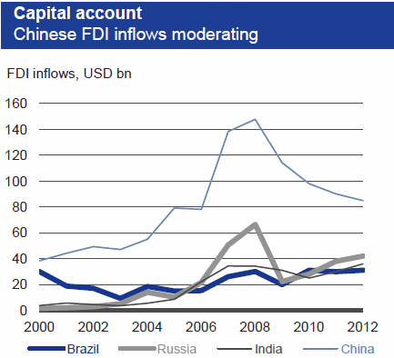
The BRIC-Countries
Source: Deutsche Bank Research 2011 (2012 est.).

Slide 12
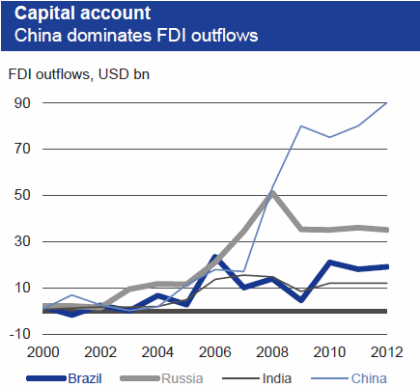
The BRIC-Countries
Source: Deutsche Bank Research 2011 (2012 est.)

Slide 13
The BRIC-Countries

Slide 14
The World Competitiveness Scoreboard of IMD
Country 2011 2010 2009 2008 2007 2006 USA 1 3 1 1 1 1 Finland 15 19 9 15 17 10
Netherlands 14 12 10 10 8 15 Singapore 3 1 3 2 2 3 Switzerland 5 4 4 4 8 8 Canada 7 7 8 8 10 7 Australia 9 5 7 7 12 6 Germany 10 16 13 16 16 26 U.K. 20 22 21 21 20 21 Taiwan 6 8 23 13 18 18 Malaysia 16 10 18 19 23 23 Korea 22 23 27 31 29 38 Japan 26 27 17 22 24 17 China 19 18 20 17 15 19 Thailand 27 26 26 27 33 32 India 32 31 30 29 48 42
Brazil 44 38 40 43 49 44 Mexico 38 47 46 50 47 53 Russia 49 51 49 47 43 54

Slide 15
Diversity in the World-Economy
 | Manage-ment/ Industrial Systems | Govermental Struktures, Laws, Regulations of Law | Values, indiv./social goals, collective normative conditions | Religious and cultural items
Brasil
Russia
India
China
EU
USA
Japan

Slide 16
Model: Systemapproach for Int. Companies
Technical System
Cultural System
International Companies
Political System
Economic System

Slide 17
II. BRIC–Countries, EU, USA

Slide 18
China
Source: CIA: The World Factbook, 2005

Slide 19
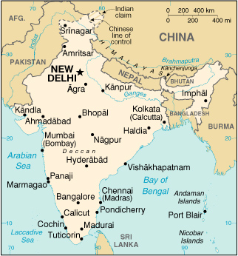
India
www.cia.gov

Slide 20
Russia
Russia
Source: www.cia.gov

Slide 21
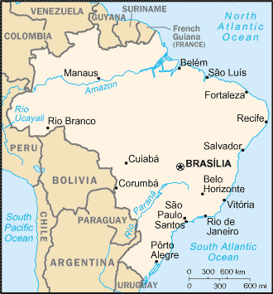
Brasil
24. October 2011
24. October 2011
www.cia.gov

Slide 22
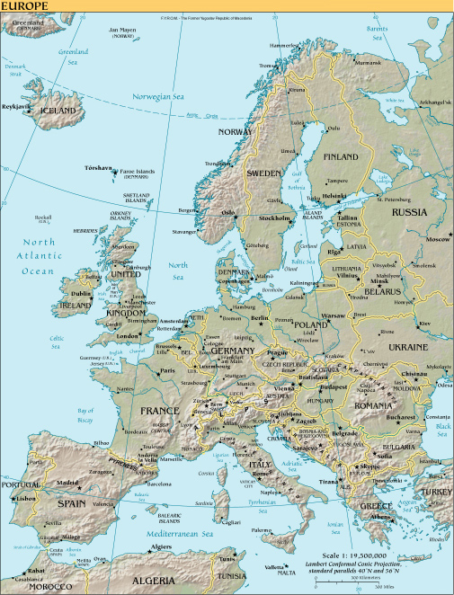
Europe
Quelle: www.cia.gov

Slide 23
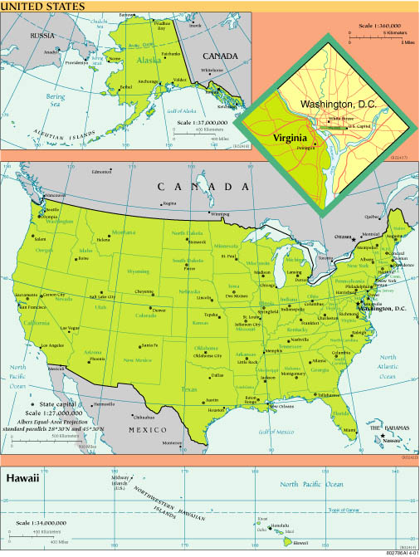
USA
www.cia.gov

Slide 24
III. BRIC – Countries
and Company-Politics

Slide 25
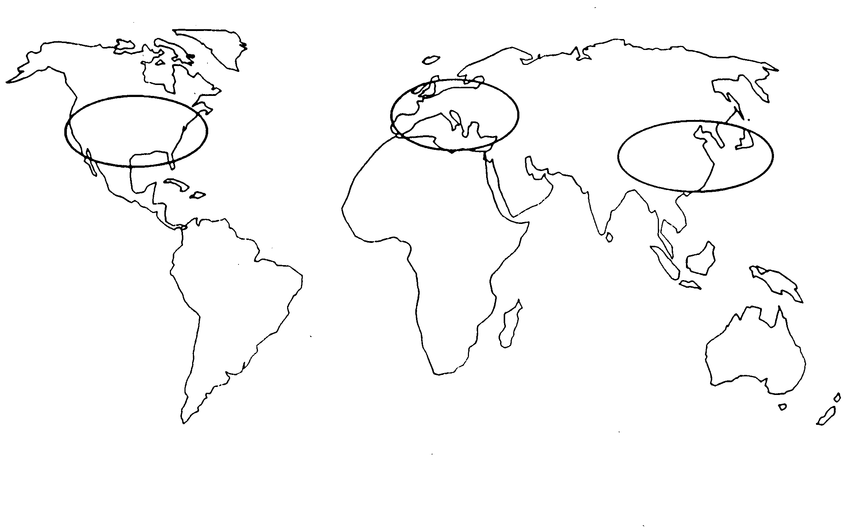
Triade-Model and the global Internationalisation
|

Slide 26
Stategies for Value Chain Optimisation
Principles of Value Chains
Country focus
National autonomy
Global Network
Produc-tion
Produc-tion
Produc-tion
Supply
R&D
Supply
R&D
Supply
R&D
Count.1
Count.2
Count.3
Count.4
Source: Ringsletter / Skrobarcyk (1994), S. 343

Slide 27
Value Chain Optimisation…
… to different functions of the Process
Consumer-Product
Value Chain
Concentration to Basicproducts / Supplyproducts
Concentration to Consumer-Product
Neutral Structure of the Value Chain
Row Material

Slide 28
3 Models in intercultural Managementresearch
Ethnocentric Approach: Headquarter oriented
Polycentric Approach: Cultural oriented to different countries
Geocentric Approach: Orientation to global best practice and intercultural combination

Slide 29
Fundamental Types of Cultures in International Companies
S a
S b
S f
H
S c
S e
S d
Ethnocentric

Slide 30
Fundamental Types of Cultures in International Companies
S a
S b
S f
H
S c
S e
S d
Polycentric
H = Headquarter S = Subsidiaries in different Countries

Slide 31
Fundamental Types of Cultures in International Companies
S a
S b
S f
H
S c
S e
S d
Geocentric
H = Headquarter S = Subsidiaries in different Countries

Slide 32
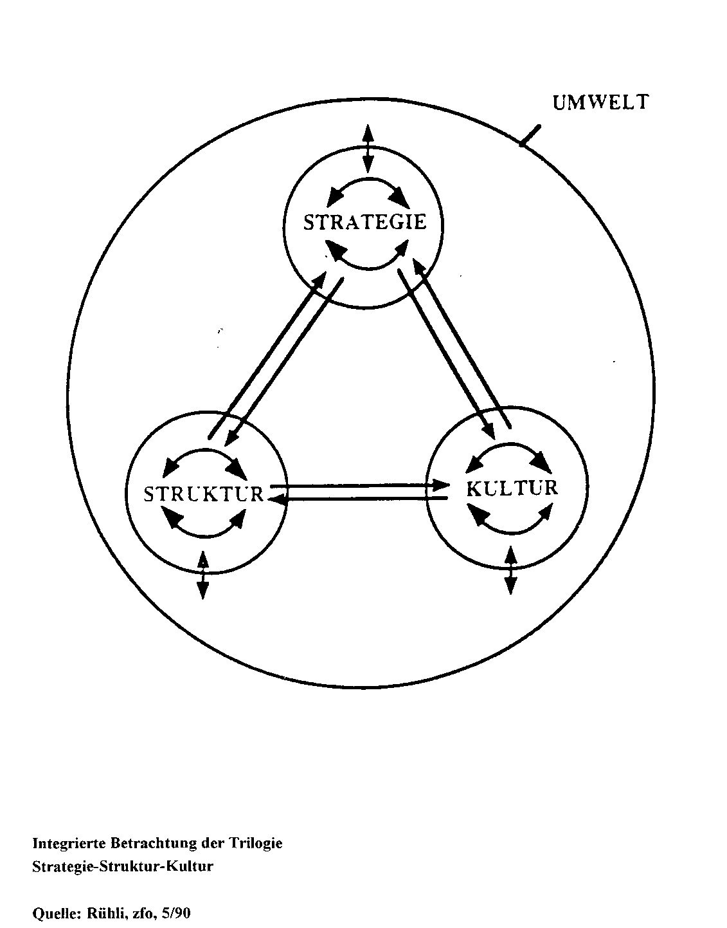
Performance of Global Companies
ENVIRONMENT
STRATEGY
STRUCTURE
CULTURE
North North /North South/South North /South North
Source: Rühli, zfo, 5/90

Slide 33
World Map via Europe

Slide 34
World Map via Asia

Slide 35
Thank you very much
for your attention

